Slide 1
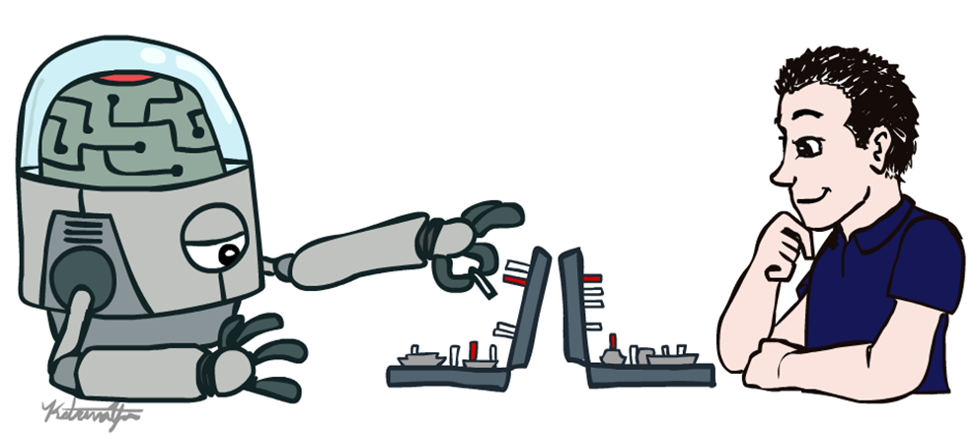
Artificial Intelligence
Introduction (a)
Dr. Rabia Tehseen
Assistant Professor
University of Central Punjab, Lahore
Modified slides of CS-188 Berkeley University

Slide 2
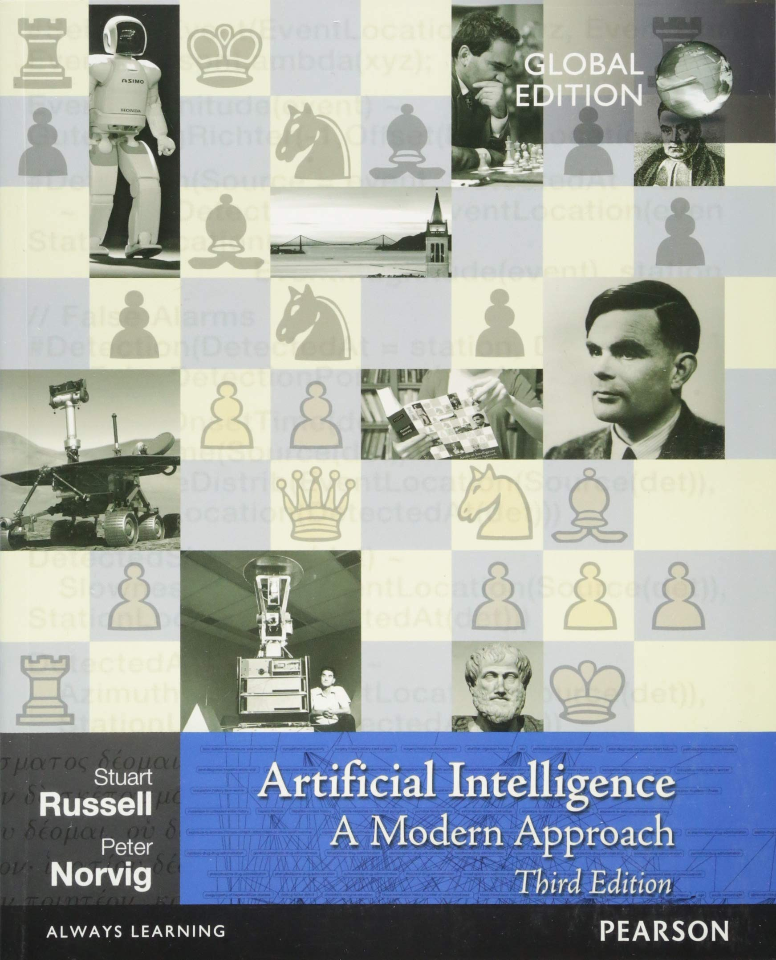
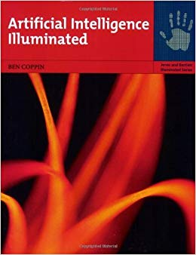
Recommended Books
Artificial Intelligence: A Modern Approach,
Russell & Norvig.
(https://faculty.psau.edu.sa/filedownload/doc-7-pdf-a154ffbcec538a4161a406abf62f5b76-original.pdf )
“Artificial Intelligence Illuminated”
Ben Coppin,
(http://futuresoft.yolasite.com/resources/Artificial%20Intelligence%20Illuminated.pdf)

Slide 3
Recommended Books
“Artificial Intelligence – Structures and Strategies for Complex problem solving”, George F. Luger, Pearson International Edition, Sixth edition, 2009.
“Artificial Intelligence: A new synthesis” Nils Nilsson, Morgan Kaufmann, 1998
UC Berkeley CS188 Intro to AI (http://ai.berkeley.edu/home.html)

Slide 4
Grading (Tentative)
ITEM | WEIGHTAGE
Quizzes | 15 %
Assignments | 15 %
Class Participation | 5%
Mid Term | 20 %
Final Term | 45 %
Total | 100

Slide 5
Logistics
Quiz may be un-announced.
Read the book
Plagiarism – Write your own Solution
Deadline of the assignments will not be extended
No Late submissions will be accepted.

Slide 6
Other Announcements
Email address:
Rabia.tehseen@ucp.edu.pk
Office:
C Block, Ground Floor, Office 7
Course Coordinator
Dr. Mohsin Ashraf

Slide 7
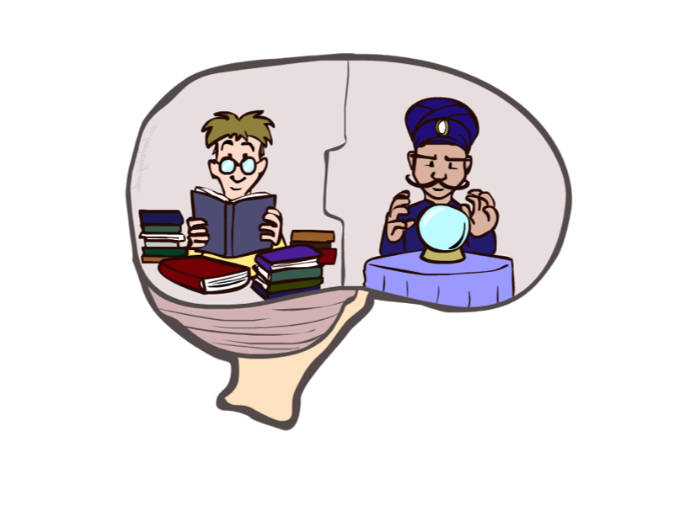
Course Topics
Part I: Solving Problems by Searching
Fast search / planning
Constraint satisfaction
Heuristics
Adversarial and uncertain search
Part II: Knowledge, reasoning, and Planning
Reasoning agents
Propositional logic
Predicate logic
Knowledge-based systems
Part III: Machine Learning
Classification
Clustering
Neural Networks

Slide 8
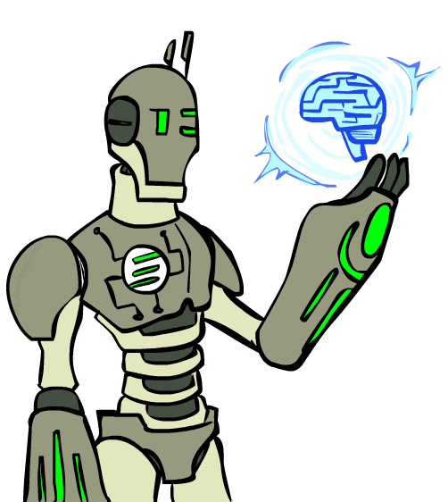
Overview
What is artificial intelligence?
What can AI do?
What is this course?

Slide 9
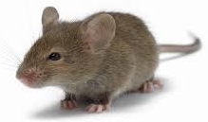
Question
Is this mouse intelligence?
It depends on context
Route planning (Yes)
Mathematical problem solving (No)
Is Google Intelligent?
Task specific intelligence
Are humans intelligent?

Slide 10
Why AI?
Two main goals of AI:
To create useful “smart” programs able to do tasks that would normally require a human expert
To understand human intelligence better as we test theories of human intelligence by writing programs which emulate them

Slide 11
What is Intelligence?
Ability of problem solving
Ability to think, plan and schedule
Efficient memory and information manipulation
Ability to tackle ambiguous and fuzzy problems
Ability to understand and perceive

Slide 12
Artificial Intelligence
“Study of computations that make it possible to perceive, reason and act.”
Branch of Science which deals with helping machines to find solutions to complex problems in a more human-like fashion
In short, putting human intelligence into machines

Slide 13
Artificial Intelligence
What is Intelligence ??
Perceive
Understand
Remember
Think
Reason
Learn from Experience
Adapt to the new Situation
Problem Solving

Slide 14
Humans Vs Machines
Humans | Machines
Symbolic calculation Natural language understanding Not very precise Knowledge Generalize from examples Deal with noisy inputs | Numeric calculation Machine Language Precise Data Cannot generalize Cannot deal with noise

Slide 15
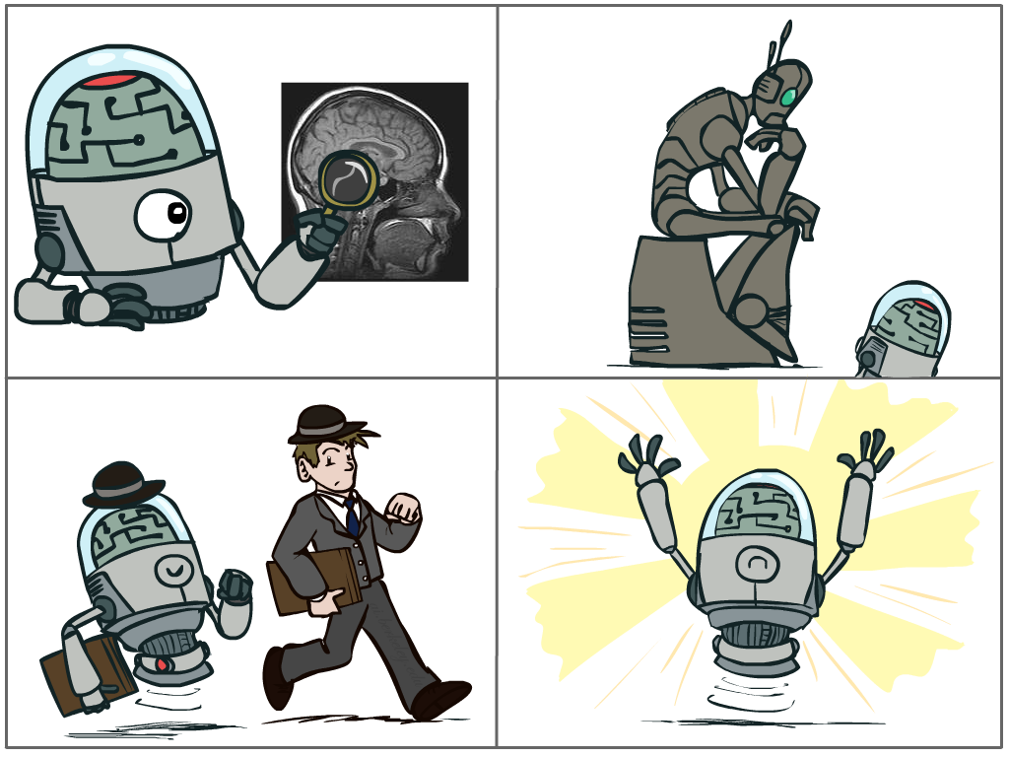
What is AI?
The science of making machines that:
Think like people
Think rationally
Cognitive modeling approach
Laws of thought approach
Act like people
Act rationally
Turing Test
approach
Rational agent approach
Notes:
Top left: Think like people --- cognitive science, neuroscience
Bottom left: act like people --- actually very early definition, dating back to Alan Turing --- Turing test; problem to do really well you start focusing on things like don’t answer too quickly what the square root of 1412 is, don’t spell too well, and make sure you have a favorite movie etc. So it wasn’t really leading us to build intelligence
Think rationally – long tradition dating back to Aristotle --- but not a winner, because difficult to encode how to think, and in the end it’s not about how you think, it’s about how you end up acting

Slide 16
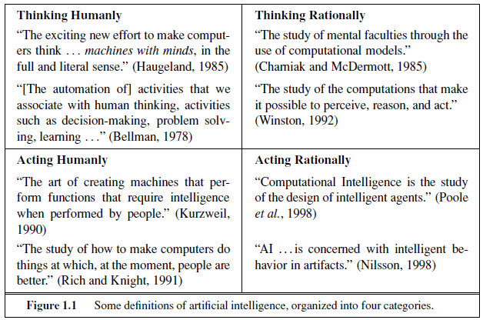
What is Artificial Intelligence

Slide 17
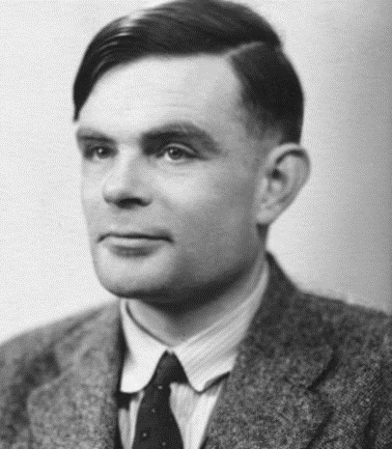
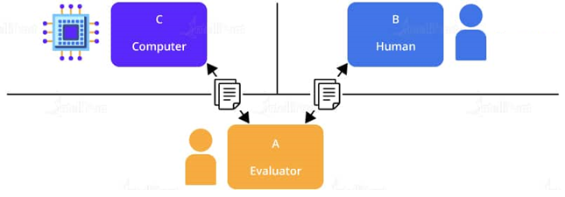
Acting Humanly: Turing Test
Alan Turing (1950) “Computing machinery and intelligence”.
A computer passes the test if a human interrogator, after posing some written questions, cannot tell whether the written responses come from a person or from a computer.

Slide 18
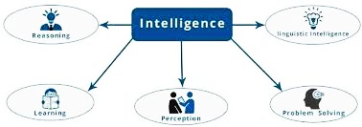
Turing Test Capabilities

Slide 19
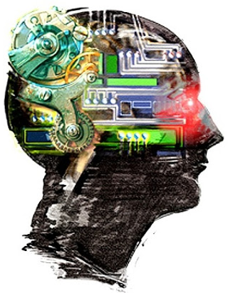
Thinking Humanly: The cognitive modeling approach
For that we must determine how humans think.
Need to get inside the actual workings of human minds.
Three ways to do this:
Through introspection
trying to catch our own thoughts
as they go by
Through psychological experiments
observing a person in action
Through brain imaging
observing the brain in action.

Slide 20
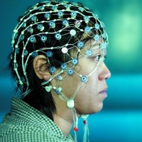
Thinking Humanly: The cognitive modeling approach
Requires scientific theories of internal activities of the brain.
Cognitive Science: Predicting and testing behavior of human subjects (Hypothesis based)
Cognitive Neuroscience: Direct identification from neurological data (Data driven)
However:
the available theories do not explain anything resembling human-level general intelligence
It may be impossible to identify the detailed structure of human problem solving using only externally-available data.

